Slide 1
INFORMATION SYSTEMS,
ORGANIZATIONS, MANAGEMENT,
AND STRATEGY

Slide 2
Objectives
What do we need to know about organizations in order to build and use information systems successfully?
What impact do information systems have on organizations?
How do information systems support the activities of managers?
How can businesses use information systems for competitive advantage?
Why is it so difficult to build successful information systems?`

Slide 3
Real World Example
Cognizant Technology Solutions grew fast to become a $1.4 billion revenue company providing IT outsourcing services.
A quick growth required that they reinvent their organization – move from a cost based to a relationship based structure.
Managers had to interact with customers and developers in different locations.
A tremendous strain was put on managers because they had to work day and night.
Some of the units adopted a matrix structure sharing managerial responsibilities.
Notes:
Refer to figure 3.1 Example of possible cognizant matrix structure.

Slide 4
Organizational Strategy
Includes the organization’s design, as well as the managerial choices that define, set up, coordinate, and control its work processes.
Optimized organizational design and management control systems support optimal business processes which reflect the firm’s values and culture.
Figure 3.3 summarizes complementary design variables from the managerial levers framework.
Three types of managerial levers:: organizational, control, cultural.
Notes:
Organizational strategy may be considered as the coordinated set of actions that leverages the use organizational design, management control systems and organizational culture to make the organization effective by achieving the organization’s objectives. The organizational strategy works best when it meshes well with the IS strategy.

Slide 5
Organizations and IT
Information technology and organizations influence one another.
Complex relationship influenced by organization’s structure, business processes, politics, culture, environment, and management decisions
Notes:
Organizational strategy may be considered as the coordinated set of actions that leverages the use organizational design, management control systems and organizational culture to make the organization effective by achieving the organization’s objectives. The organizational strategy works best when it meshes well with the IS strategy.

Slide 6
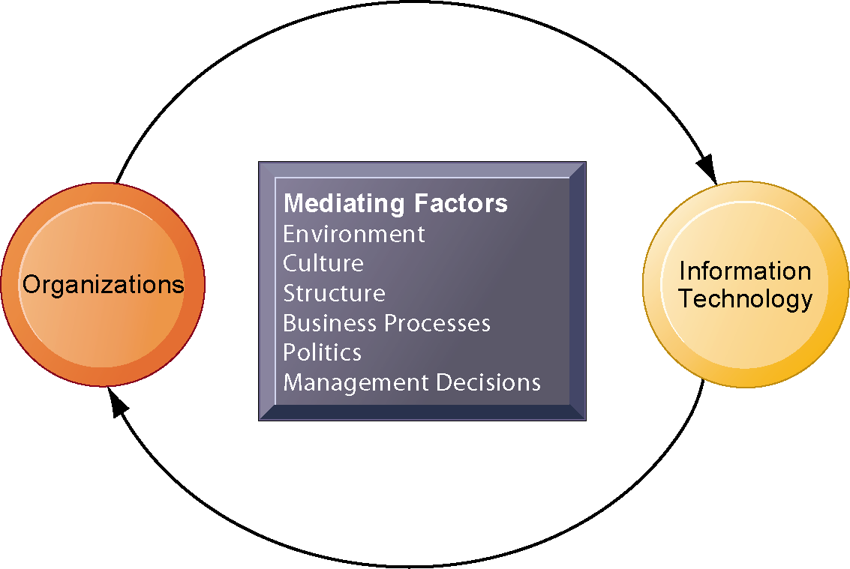
Organizations and IT
The Two-Way Relationship Between Organizations and Information Technology
This complex two-way relationship is mediated by many factors, not the least of which are the decisions made—or not made—by managers. Other factors mediating the relationship include the organizational culture, structure, politics, business processes, and environment.
Notes:
Ask students to explain how each factor might affect the relationship between organizations and information technology. Emphasize to students that the relationship between these two and its effects on the future of a business are difficult to predict. For example, very few people could have predicted the prominence of e-mail and instant messaging in business communication 15 years ago.

Slide 7
Objectives
What do we need to know about organizations in order to build and use information systems successfully?
What impact do information systems have on organizations?
How do information systems support the activities of managers?
How can businesses use information systems for competitive advantage?
Why is it so difficult to build successful information systems?`

Slide 8
Organizations and IT What is an organization?
Technical definition:
Stable, formal social structure that takes resources from environment and processes them to produce outputs
A formal legal entity with internal rules and procedures, as well as a social structure
Behavioral definition:
A collection of rights, privileges, obligations, and responsibilities that is delicately balanced over a period of time through conflict and conflict resolution.

Slide 9
Organizations and IT What is an organization?
microeconomic definition of organizations
Capital and labor (the primary production factors provided by the environment) are transformed by the firm through the production process into products and services (outputs to the environment).
The products and services are consumed by the environment, which supplies additional capital and labor as inputs in the feedback loop.
Notes:
Ask students what are the inputs from the environment? What do organizations output (goods and services). In this view, the organization or business firm is rather easily changed, and malleable. The organization is a collection of parts, like a machine, that can be re-arranged as needed. There are no humans in this model, or if there are, they are assumed to be relatively simple.

Slide 10
Organizations and IT What is an organization?
The Behavioral View of Organizations
The behavioral view of organizations emphasizes group relationships, values, and structures.
Notes:
In this view, the business firm is a little more difficult to change rapidly or on command because it is a very complex machine populated with human beings. Firms operate with an existing hierarchy, job definitions, business rules, procedures and processes. Efficient organizations become very good at these elements of business. Changing these elements takes more time.

Slide 11
Variable | Description
Organizational variables
Decision rights | Authority to initiate, approve, implement, and control various types of decisions necessary to plan and run the business.
Business processes | The set of ordered tasks needed to complete key objectives of the business.
Formal reporting relationships | The structure set up to ensure coordination among all units within the organization.
Informal networks | Mechanism, such as ad hoc groups, which work to coordinate and transfer information outside the formal reporting relationships.
Control variables
Data | The information collected, stored, and used by the organization.
Planning | The processes by which future direction is established, communicated, and implemented.
Performance measurement and evaluation | The set of measures that are used to assess success in the execution of plans and the processes by which such measures are used to improve the quality of work.
Incentives | The monetary and non-monetary devices used to motivate behavior within an organization.
Cultural variables
Values | The set of implicit and explicit beliefs that underlie decisions made and actions taken.
Notes:
Which of the two definitions do students find more appealing and why? It is important to consider both definitions rather than exclusively use one at the expense of the other. The two definitions are complementary.

Slide 12
Organizations and IT What is an organization?
Features of organizations - All modern organizations share some characteristics, such as:
Use of hierarchical structure
Accountability, authority in system of impartial decision making
Adherence to principle of efficiency
Other features include:
Routines and business processes and organizational politics, culture, environments and structures
Notes:
You could ask students to envision what would happen to an organization that did not use a hierarchical structure (would anything get done?), did not adhere to the principle of efficiency (would they provide any good or service worth using at an affordable price?), etc.

Slide 13
Organizations and IT What is an organization?
Routines and business processes
Routines (standard operating procedures)
Precise rules, procedures, and practices developed to cope with virtually all expected situations
Business processes: Collections of routines
Business firm: Collection of business processes
Notes:
You could ask students to describe examples of situations where a business they have interacted with has had a well-understood set of routines. One such example is at the doctor’s office, where the receptionist, nurses, and doctors all have a defined set of routines. Ask students to think about and describe routines they performed on their jobs.

Slide 14
Organizations and IT What is an organization?
Organizational culture:
Encompasses set of assumptions that define goal and product
What products the organization should produce
How and where it should be produced
For whom the products should be produced
May be powerful unifying force as well as restraint on change
Notes:
Culture may seem like a pretty abstract idea to many students. Ask students to describe organizational cultures they have experienced while on the job, or other areas of their lives. What kind of organizational culture do students prefer and why? Ask students to describe different kinds of cultures and what types of firms are more likely to have them.

Slide 15
Organizations and IT What is an organization?
Organizational environments:
Organizations and environments have a reciprocal relationship
Organizations are open to, and dependent on, the social and physical environment
Organizations can influence their environments
Environments generally change faster than organizations
Information systems can be instrument of environmental scanning, act as a lens.
Notes:
Explain that environmental scanning involves searching for and determining external changes that may require an organizational response. The current economic climate represents an example of external change that require sweeping organizational responses to ensure survival.

Slide 16
IT and Organization design
IT in the organization’s physical structure is designed to facilitate the communication and work processes necessary and management control to accomplish the organization’s goals.
Disruptive technology can bring sweeping change to businesses, industries and markets.
However, culture impacts IT and organizational performance.
Notes:
Managerial levers: Organizational
Ensure that students understand that the PageRank algorithm is the underlying technology behind Google search.
Ask students if they can give examples of any first movers that invented a disruptive technology, yet failed to last (examples might include the Altair personal computer, the Netscape Navigator Internet browser, etc.).

Slide 17
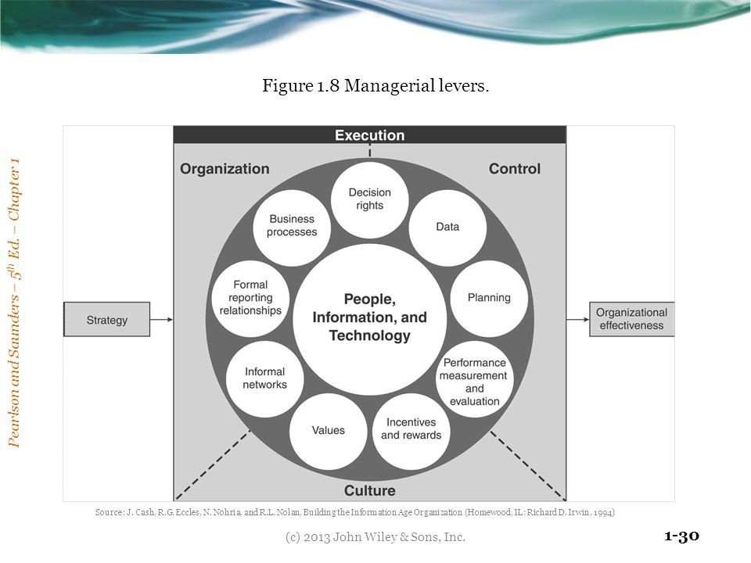
Organizational structure Managerial levers model
Notes:
Do students agree with the classification of these types of organizational
structure? Can they come up with examples for each type of organization?
Adhocracy is a flexible, adaptable and informal form of organization that is defined by a lack of formal structure

Slide 18
Organizational Structures
Organization structure is the way of designing an organization so that decision rights are correctly allocated.
The structure of reporting relationships typically reflects the flow of communication and decision making throughout the organization.
Traditional organizations: hierarchical, flat or matrix.
Newer organizational form: The networked structure, Social networks and virtual communities.
Notes:
Managerial levers: Organizational

Slide 19
Organizational Structures
Entrepreneurial: Start-up business
Machine bureaucracy: Midsize manufacturing firms
Divisionalized bureaucracy: Fortune 500
Professional bureaucracy: Law firms, hospitals, school systems
Adhocracy: Consulting firm
Notes:
Do students agree with the classification of these types of organizational
structure? Can they come up with examples for each type of organization?
Adhocracy is a flexible, adaptable and informal form of organization that is defined by a lack of formal structure

Slide 20
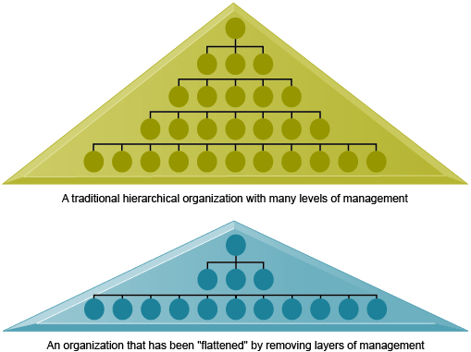
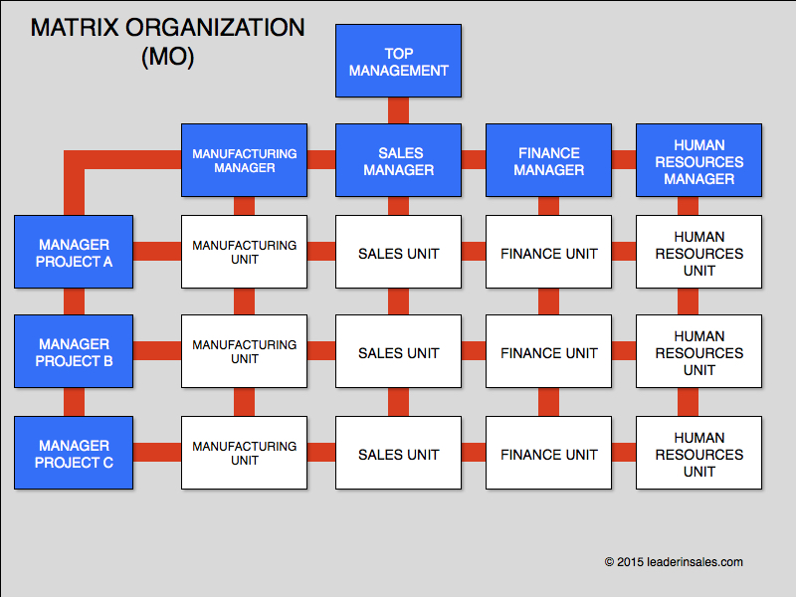
Organizational Structures
Notes:
Do students agree with the classification of these types of organizational
structure? Can they come up with examples for each type of organization?
https://www.forbes.com/sites/jacobmorgan/2015/07/08/the-5-types-of-organizational-structures-part-2-flatter-organizations/#d23b0776dac3
Adhocracy is a flexible, adaptable and informal form of organization that is defined by a lack of formal structure

Slide 21
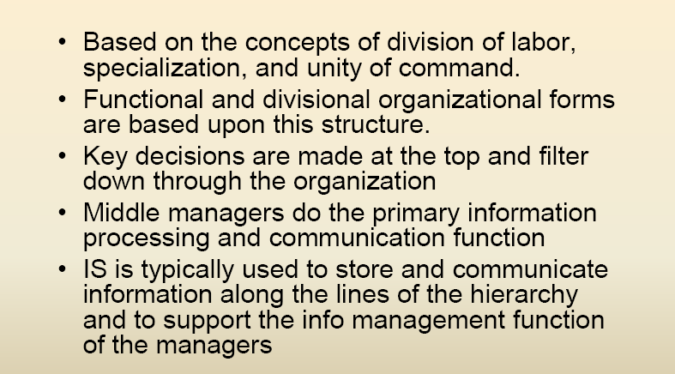
Hierarchical Structure
Notes:
Do students agree with the classification of these types of organizational
structure? Can they come up with examples for each type of organization?
Adhocracy is a flexible, adaptable and informal form of organization that is defined by a lack of formal structure

Slide 22
It and Hierarchical Structure
IT is typically used to store and communicate information along the lines of the hierarchy in a centralized structure.
IT facilitates the decisions of top managers downward and provide a hierarchy of reports to support organizational operations.
Data from operations that have been captured at lower levels need to be consolidated, managed and made secure at a higher level.
The data is integrated into databases that are designed to enable employees at all levels of the organization can see the information that they need when they need it.
Notes:
IS support the information needs of managers throughout the organization.

Slide 23
Flat Organization Structure
Horizontal, less well-defined chain of command.
Fewer employees, everyone does whatever needs to be done in order to complete business.
Respond quickly to dynamic, uncertain environments.
Teamwork is important to increase flexibility and innovation.
Decision rights may not be clearly defined, often decentralized.
Notes:
As the work grows, new individuals are added to the organization, and eventually a hierarchy is formed where divisions are
responsible for segments of the work processes.

Slide 24
Flat Organization Structure
Appropriate for entrepreneurial/small organizations.
IT is utilized to off-load certain routine work in order to avoid hiring additional workers and supports intra-firm communications.
Notes:
As the work grows, new individuals are added to the organization, and eventually a hierarchy is formed where divisions are
responsible for segments of the work processes.

Slide 25
Matrix Organization Structure
Assigns workers with two or more supervisors.
Work is organized into small work groups and integrated regionally and nationally/globally.
Each supervisor directs a different aspect of the employee’s work.
Difficult for managers to achieve their business strategies
Managers are flooded with more information than they can process.
Decision rights are shared between the managers.
Notes:
The matrix structure allows organizations to concentrate on both functions and purpose.
Weaknesses- each boss has a well-defined area of authority, the employees often find the matrix organization structure frustrating and confusing since they are often subjected to dual authority. Cognizant probably moved to the matrix structure from a hierarchical structure.

Slide 26
Matrix Organization Structure
Appropriate for complex decision making and dynamic and uncertain environments.
IT reduces operating complexities and expenses by allowing information to be easily shared among different managerial functions.
Notes:
The matrix structure allows organizations to concentrate on both functions and purpose.
Weaknesses- each boss has a well-defined area of authority, the employees often find the matrix organization structure frustrating and confusing since they are often subjected to dual authority. Cognizant probably moved to the matrix structure from a hierarchical structure.

Slide 27
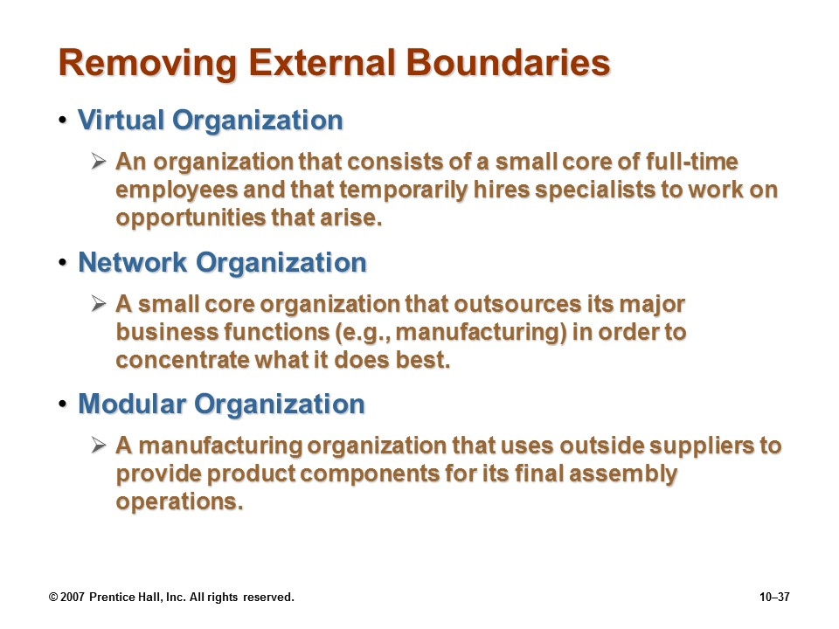
Removing external boundaries

Slide 28
Virtual Organization Structure
Uses networks to link people, assets, and ideas to create and distribute products and services without being limited to traditional organizational boundaries or physical locations
e.g. Calyx.
Other examples ?

Slide 29
Network Organization Structure
Feel flat and hierarchical at the same time.
Appropriate for dynamic, unstable environments.
Highly decentralized decision rights.
Utilize distributed information and communication systems to replace inflexible hierarchical controls with controls based in IS.
Employees share their knowledge and experience, and participate in making key organizational decisions.
IT is fundamental to process design, improve process efficiency, effectiveness, and flexibility.
Notes:
Networked organizations are defined by their ability to promote creativity and flexibility while maintaining operational process control.

Slide 30
IT & Network Organization
Extensive use of communication technologies and networks.
IT is used primarily as a communication vehicle.
IT ties together people, processes, and units.
Data are gathered and stored in centralized data warehouses for use in analysis and decision making.
Decision making is more timely and accurate because data are collected and stored instantly.
Technological leveling - technology enables individuals from all parts of the organization to reach all other parts of the organization.
Notes:
Zara’s organization structure appear networked.

Slide 31
Social Network
Computer and information technologies facilitate collaboration across distances, social networks and virtual communities are formed.
Useful in getting a job done, even if not all of the members of the network belong to the same organization. (i.e. LinkedIn)
Social network is an IT-enabled network that links individuals together in ways that enables them to find experts, get to know colleagues, and see who has relevant experience for projects across traditional organization lines.

Slide 32
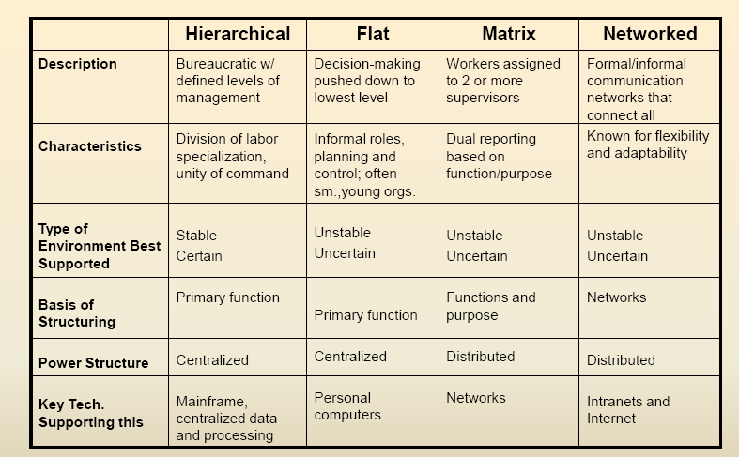
organizational structures Comparison
Notes:
Do students agree with the classification of these types of organizational
structure? Can they come up with examples for each type of organization?
Adhocracy is a flexible, adaptable and informal form of organization that is defined by a lack of formal structure

Slide 33
Objectives
What do we need to know about organizations in order to build and use information systems successfully?
What impact do information technologies have on organizations?
How do information systems support the activities of managers?
How can businesses use information systems for competitive advantage?
Why is it so difficult to build successful information systems?`

Slide 34
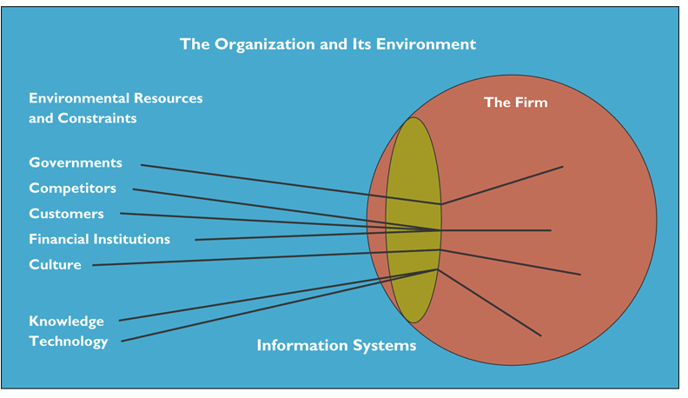
Identifying external changes

Slide 35
Economic impacts
Information systems technology is a factor of production, like capital and labor.
IT changes relative costs of capital and information and its’ quality
Information technology helps firms contract in size because it can reduce transaction costs (the cost of participating in markets)
Notes:
IT figures to replace the function of more middle managers as time passes, as well as reduce the need for other forms of capital (buildings, machinery). Ensure that students understand what is meant by ‘economics of information’ and why outsourcing is a possibility due to IT.

Slide 36
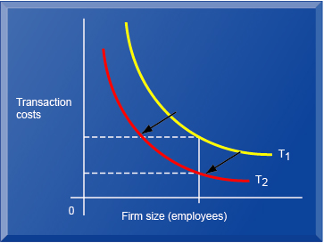
Transaction cost theory

Slide 37
Transaction cost theory
information systems technology can be seen as a factor of production that can be freely substituted for capital and labor.
As information systems technology automates the production process, less capital and labor are required to produce a specified output.
Shrinking in size - Information systems can help firms increase revenue while shrinking in size by obtaining goods and services more cheaply from outside sources
Lowering cost - organizations grow in size because they can obtain certain products or services internally at lower cost than by using external firms in the marketplace.

Slide 38
Organizational & behavioral impacts
Postindustrial organizations
Organizations flatten because in postindustrial societies, authority increasingly relies on knowledge and competence rather than formal positions
IT helps flattening organizations
Decision making pushed to lower levels
Fewer managers needed (IT enables faster decision making and increases span of control)
Notes:
Ask students to explain what is meant by authority relying on knowledge and competence rather than formal positions. Why might this ‘flatten’ and organization? The idea here is that with sufficient IT, competent workers will be able to accomplish more on their own than they would under a more concrete hierarchy.

Slide 39
Organizational & behavioral impacts
Organizational resistance to change
Information systems become bound up in organizational politics because they influence access to a key resource – information
Information systems potentially change an organization’s structure, culture, politics, and work
Most common reason for failure of large projects is due to organizational and political resistance to change
Notes:
Explain what is meant by changes in culture and politics of the firm. For example, workers may resist changes that disrupt their routines. Also explain to students that as important as technical understanding of information systems may be for potential managers, it is equally important to understand the people and organizational structures and customs affected by information systems.

Slide 40
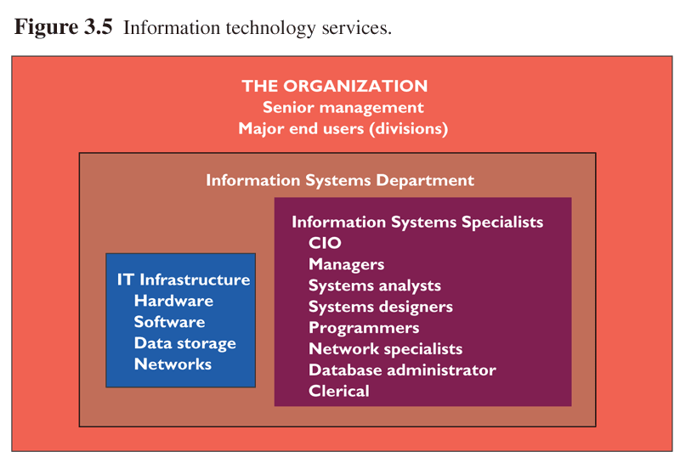
Organizational & behavioral impacts

Slide 41
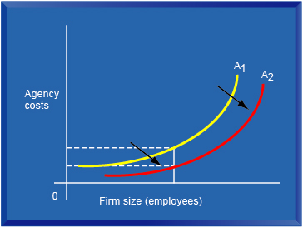
agency cost theory

Slide 42
agency cost theory
Agency theory views the firm as a nexus of contracts among self- interested individuals, who must be carefully supervised to ensure they pursue the interests of the organization.
Reducing coordinating costs - Information technology can help reduce the costs of coordinating many different people and activities, so that each manager can oversee a larger number of employees.
Flattening the org - Behavioral researchers have theorized that information technology facilitates flattening of hierarchies by broadening the distribution of information to empower lower-level employees and increase management efficiency

Slide 43
Objectives
What do we need to know about organizations in order to build and use information systems successfully?
What impact do information technologies have on organizations?
How do information systems support the activities of managers?
How can businesses use information systems for competitive advantage?
Why is it so difficult to build successful information systems?`

Slide 44
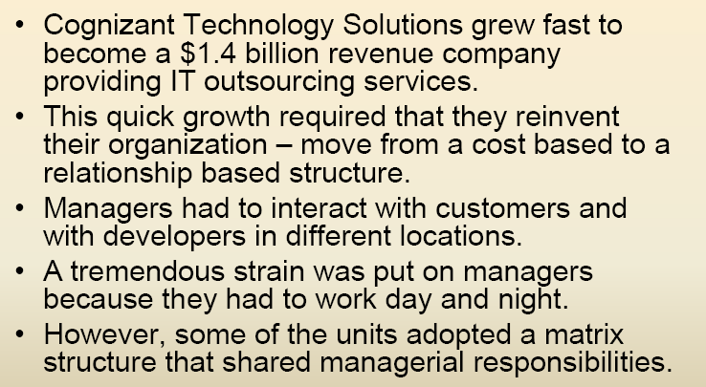
Real world examples

Slide 45
Organizational structure Managerial levers model
Notes:
Do students agree with the classification of these types of organizational
structure? Can they come up with examples for each type of organization?
Adhocracy is a flexible, adaptable and informal form of organization that is defined by a lack of formal structure

Slide 46
It support of management Management models
Classical Model of Management:
Traditional, focuses on formal functions: plan, organize, coordinate, decide, control
Behavioral Model of Management:
management based on observations of managers on the job
much less formal
preference for oral reports

Slide 47
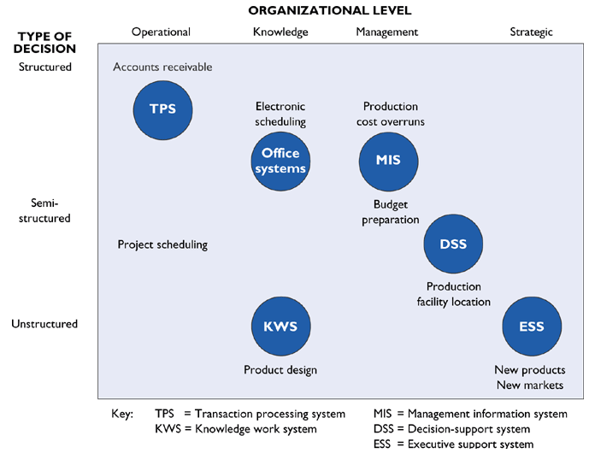
It support of management Different kinds of IT for various levels and types of decisions

Slide 48
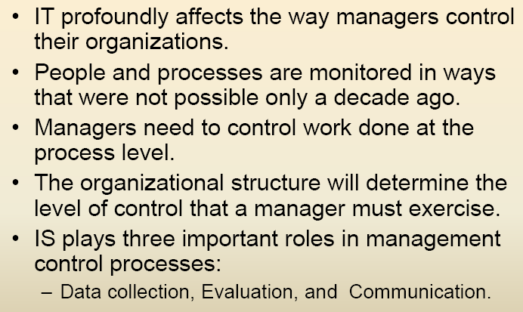
It support of management
Management control

Slide 49
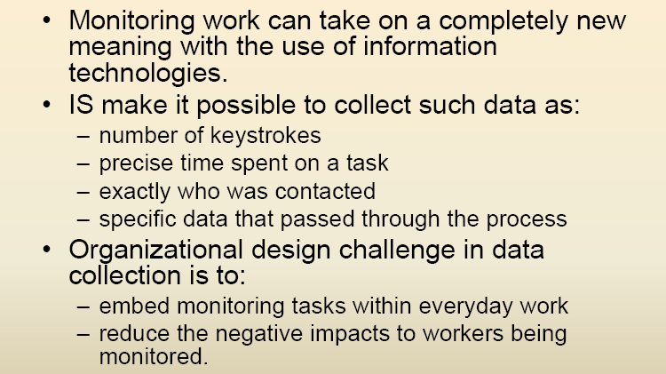
It support of management
Management control – data collection

Slide 50
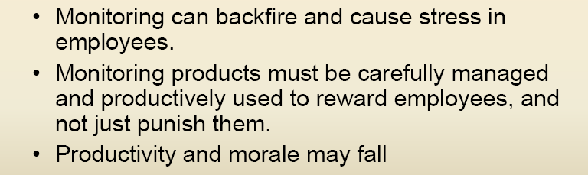
It support of management
Management control – data collection

Slide 51
It support of management
Management control – evaluation
IS make it possible to evaluate actual performance data against reams of standard or historical data.
Use models and simulations.
Managers can easily understand work progress and performance.
How the information is has significant organizational consequences.
Information collected for evaluation may be used to provide feedback
Notes:
Managerial levers: Management control systems.

Slide 52
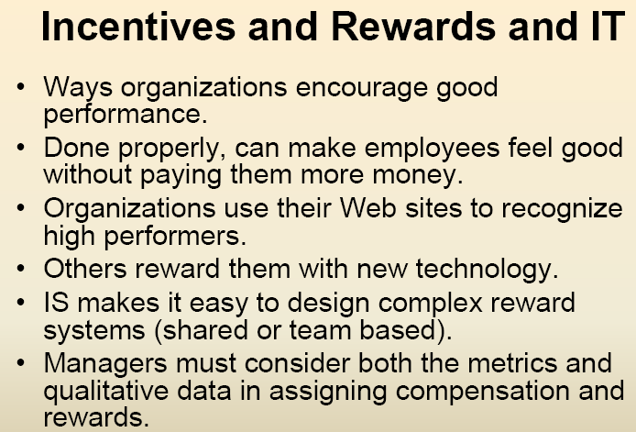
It support of management
Management control – evaluation

Slide 53
It support of management
Management control – communication
How feedback is communicated in the organization plays a role in affecting behavior.
Many companies do a “360-degree” feedback, into which the individual’s supervisors, subordinates, and coworkers all provide input.
IS enables soliciting feedback from anyone who has access to the system and report it anonymously (discreetly and appropriately).
Quick feedback enables faster improvements.
Notes:
A simple example is the feedback built into an electronic form that will not allow it to be submitted until it is
properly filled out.

Slide 54
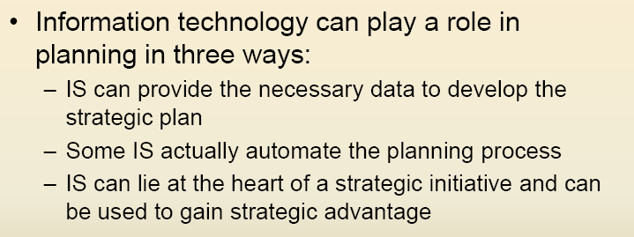
It support of management
Management control – planning
IS SUPPORT OF MANAGEMENT

Slide 55
It support of management
Management control
Systems Should Be Designed with the Following Characteristics:
Flexible - provide many options for handling data and evaluating information
Capable of supporting a variety of styles
Keep track of many activities
Sensitive to the organization’s bureaucratic and political requirements

Slide 56
Organizational structure Managerial levers model
Notes:
Do students agree with the classification of these types of organizational
structure? Can they come up with examples for each type of organization?
Adhocracy is a flexible, adaptable and informal form of organization that is defined by a lack of formal structure

Slide 57
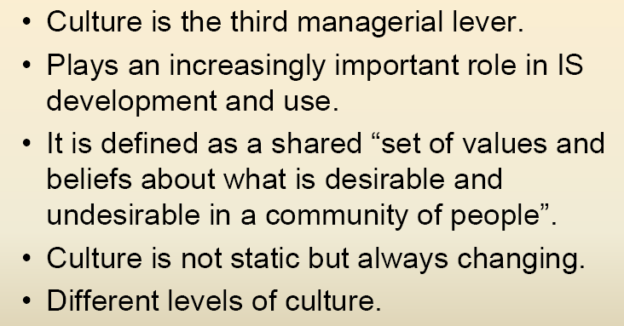
culture

Slide 58
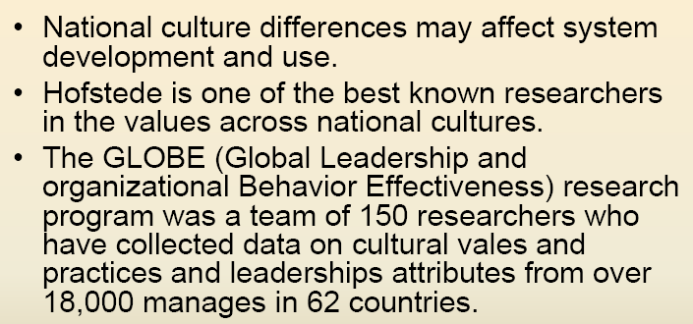
culture

Slide 59
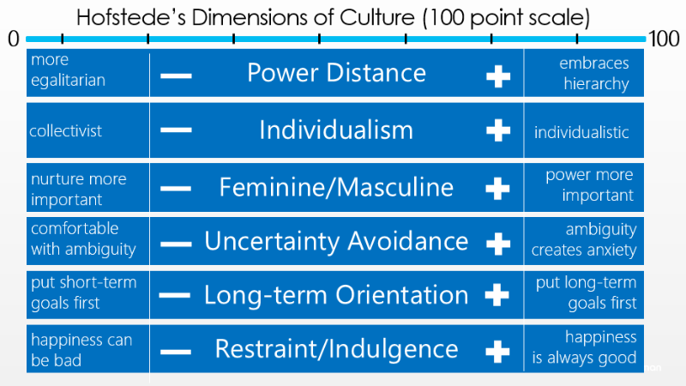

Slide 60
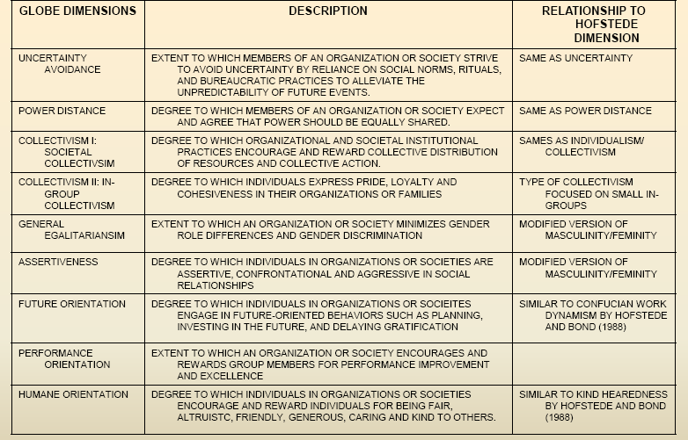
Culture
National cultural dimensions

Slide 61
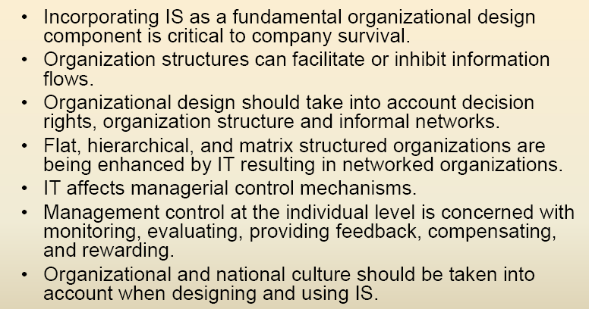
summary

